Slide 1
Degree Progress Tracker
Line 39

Slide 2
Meet The Team
Austin Benton
Blaine Prestenbach
Lorenzo Basili
Alberto Gonzalez
Notes:
Everyone introduces themselves

Slide 3
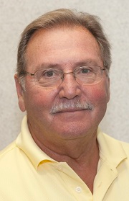
Our Client
Robert M. (Bob) Deeb
Previously an instructor in the Computer Science and Industrial Technology Department at Southeastern Louisiana University

Slide 4
Vision Statement
For students who need a more efficient way to track degree progress throughout the three computer science degrees at SELU.
The Degree Progress Tracker is a mobile application that will provide an in-depth breakdown of a student’s progress towards each degree.
Unlike other services our product will report progress towards degrees that students are not majoring in.

Slide 5
Our Stack
Front End:
React Native
Back End:
Database
SQL Express using Entity Framework
API
.NET Core

Slide 6
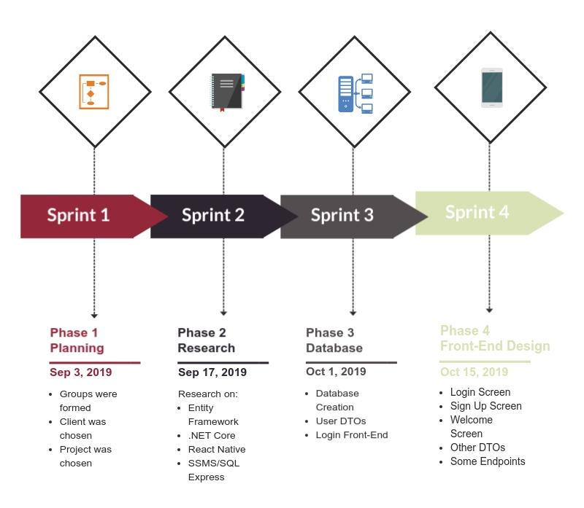
Our Work
So Far

Slide 7
Demo using Swagger

Slide 8
Future Plans
Connect front end to back end
Improve user experience on front end
Allow user to select courses
Display degree progress to user
Add other degrees

Slide 9
Questions? Suggestions?

